Slide 1
Tensor Factorizations & Applications Evrim Acar Simula Metropolitan Center for Digital Engineering Oslo, Norway
TexPoint fonts used in EMF.
Read the TexPoint manual before you delete this box.: AAA

Slide 2



Matrix Factorizations in Data Mining
terms
topic 1
topic 2
topic R
Capturing underlying
hidden factors/patterns
+
+
…
+
≈
users
customers
…
Incomplete Matrix Factorization/
Matrix Completion
+
+
+
≈
=
movies

Slide 3
Data is often squeezed to be two-way!
2-way
Social networks : <users, keywords>
<employee, employee>
<users, users>
Text mining: < documents, terms>
Recommender
Systems: <customers, items>
Computer vision: <people, pixels>
Neuroscience: <electrodes, time>
keywords
users

Slide 4
Data is often squeezed to be two-way!
2-way
Multi-way
Social networks : <users, keywords> < users, keywords, time>
<employee, employee> < employee, employee, time>
<users, users> < users, users, communication type>
Text mining: < documents, terms> < documents, terms, terms>
Recommender
Systems: <customers, items> <customers, items, tags>
Computer vision: <people, pixels> <people, pixels, viewpoints>
Neuroscience: <electrodes, time> <electrodes, time, frequency>
<electrodes, time, subjects>
keywords
time
keywords
users
users

Slide 5


Data is often multi-way!
conversation 1
conversation 2
conversation R
Capturing underlying
hidden factors/patterns
time
…
≈
+
+
+
users
terms
locations
…
Incomplete Tensor Factorization/Tensor Completion
≈
=
+
+
+
users
activities

Slide 6







Matrix Factorizations in Data Mining
Matrix Factorizations
≈
+
+ …+
Matrix Completion
≈
+
+…+
=
Data sets are often multi-way: Tensor Factorizations
Tensor Factorizations
≈
+
+…+
Tensor Completion
≈
+
+…+
=
Data sets often come from multiple sources: Data Fusion
Coupled Matrix Factorizations
Coupled Tensor Factorizations

Slide 7

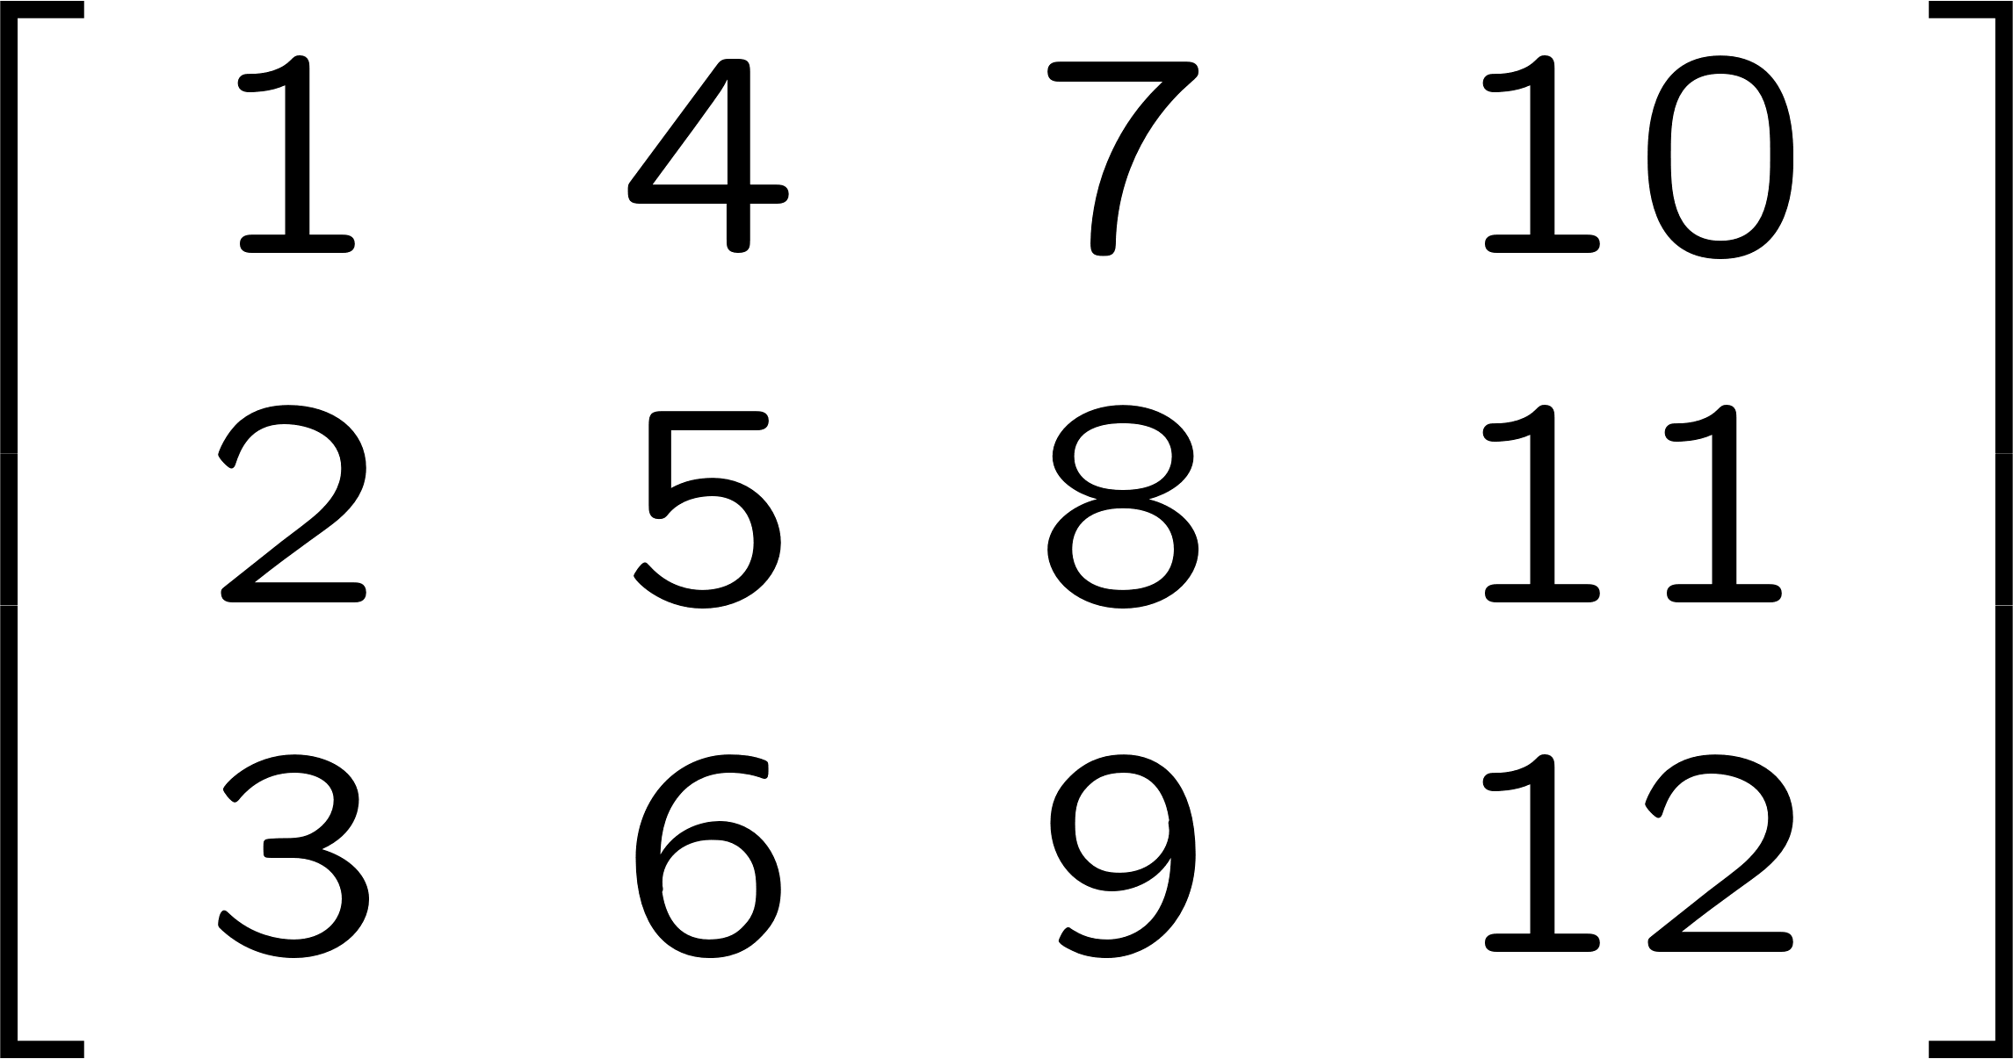
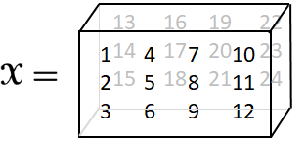

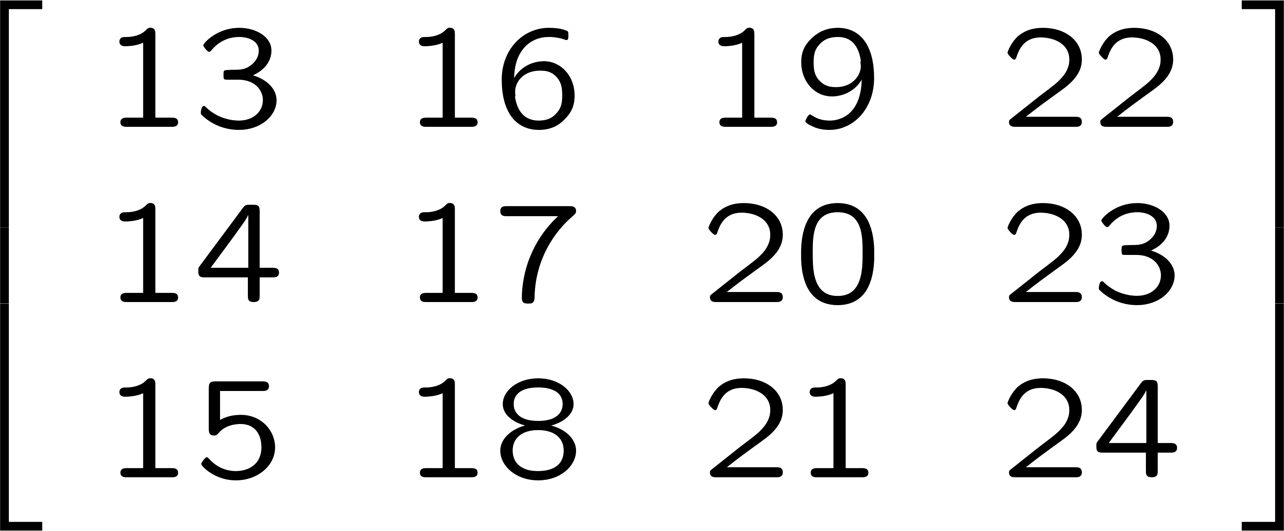


Tensors: Terminology
Order: Number of
Modes or Ways
higher-order
tensors
(multi-way arrays)
first-order tensor
(vector)
second-order tensor
(matrix)
third-order tensor
(three-way array)
Frontal
slices
Vertical
slices
Horizontal
slices
Order: 3
Frontal slices
Size:

Slide 8
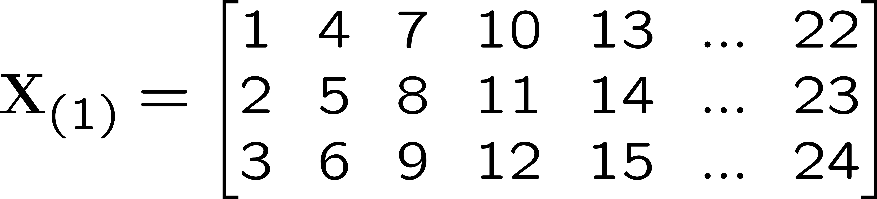
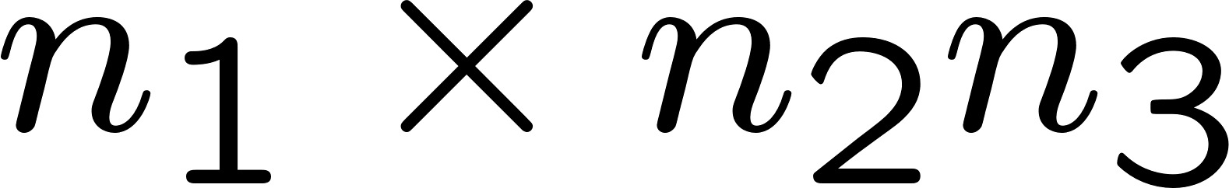
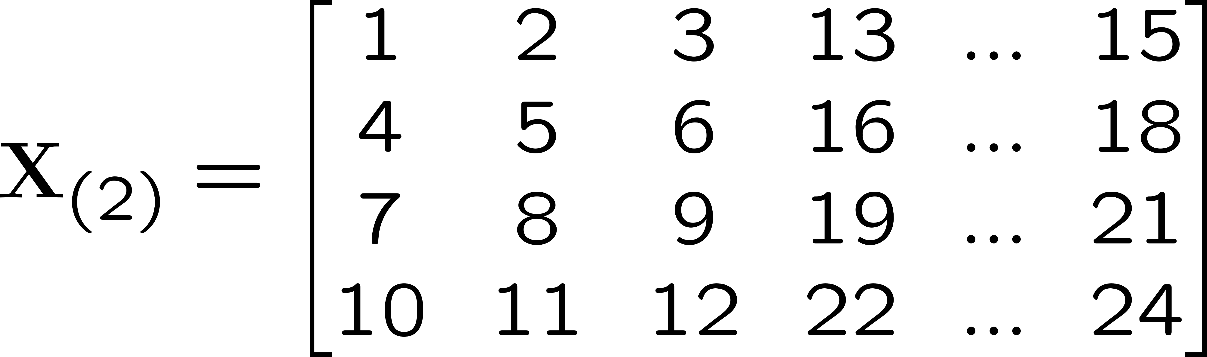
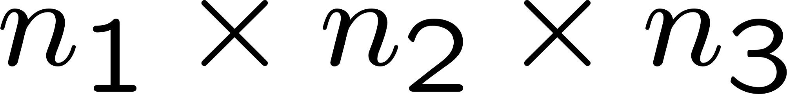
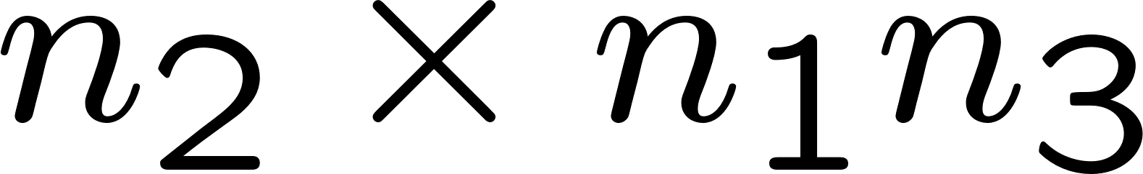
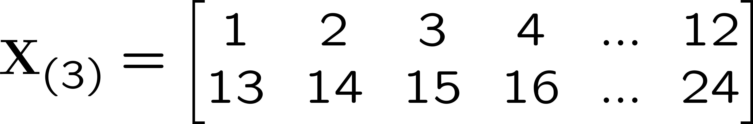
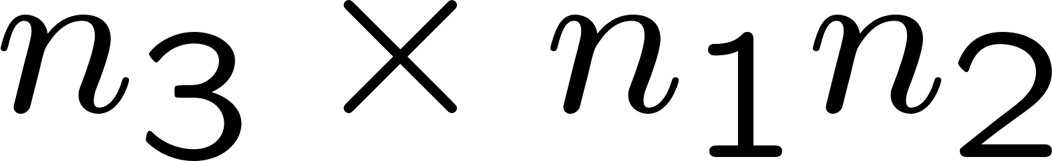
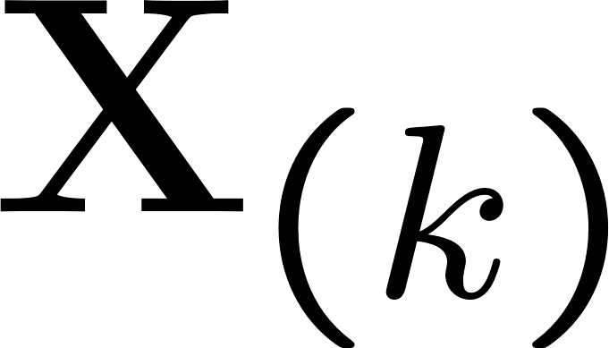
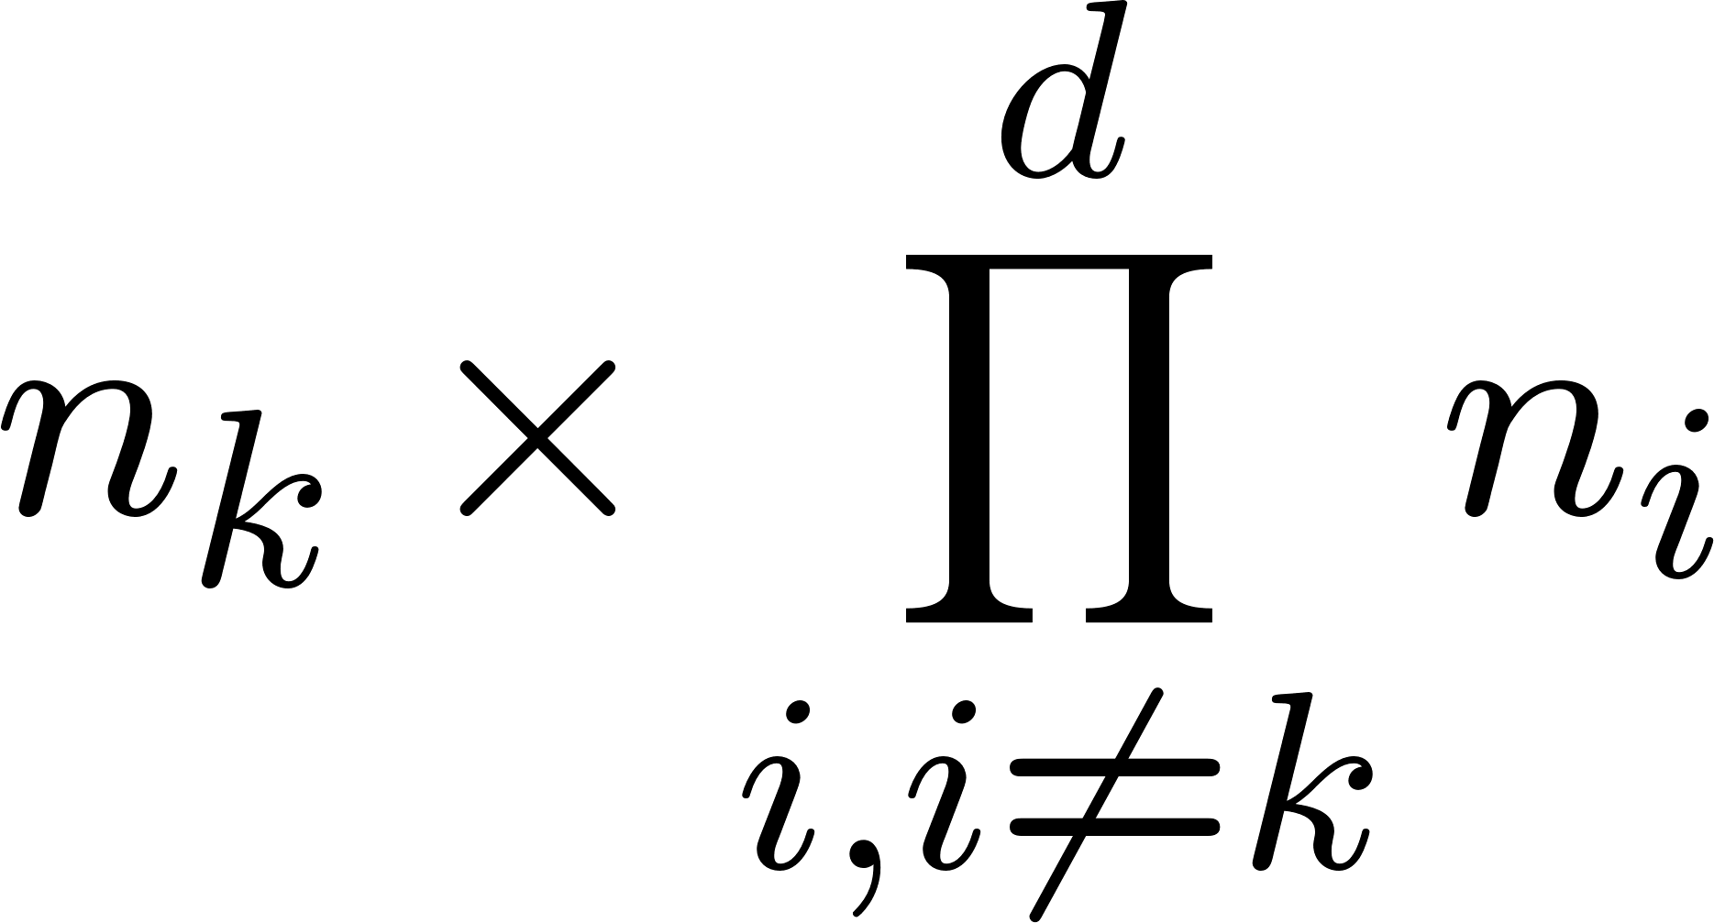
Tensors: Basic Operations
Matricization (a.k.a. Unfolding or Flattening)
Rows
(mode-2 fibers)
Columns
(mode-1 fibers)
Tubes
(mode-3 fibers)
Size:
Unfolding a d-way array (mode-k unfolding)
Size:

Slide 9









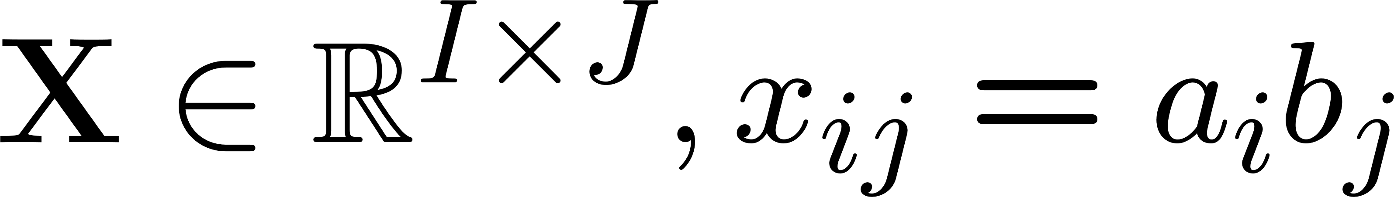

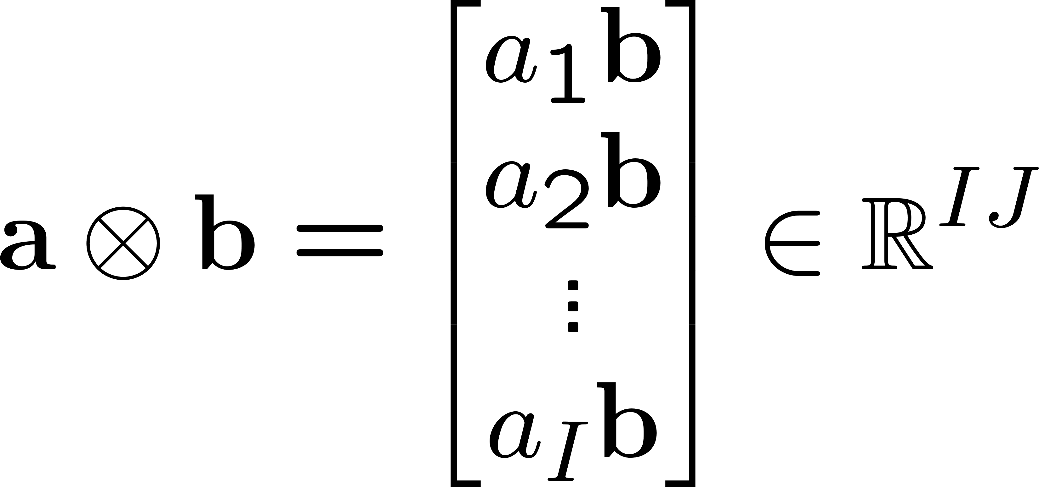
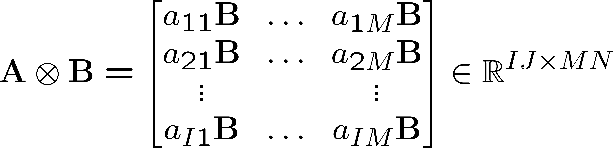

Tensors: Basic Operations (cont.)
Vector outer product
=
=
Kronecker product
Khatri-Rao product (Columnwise Kronecker Product)

Slide 10
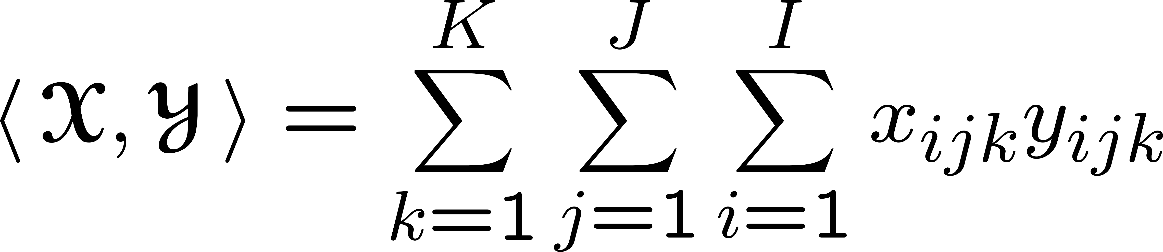



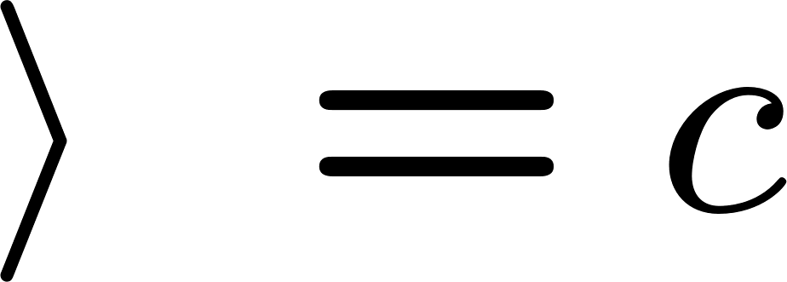
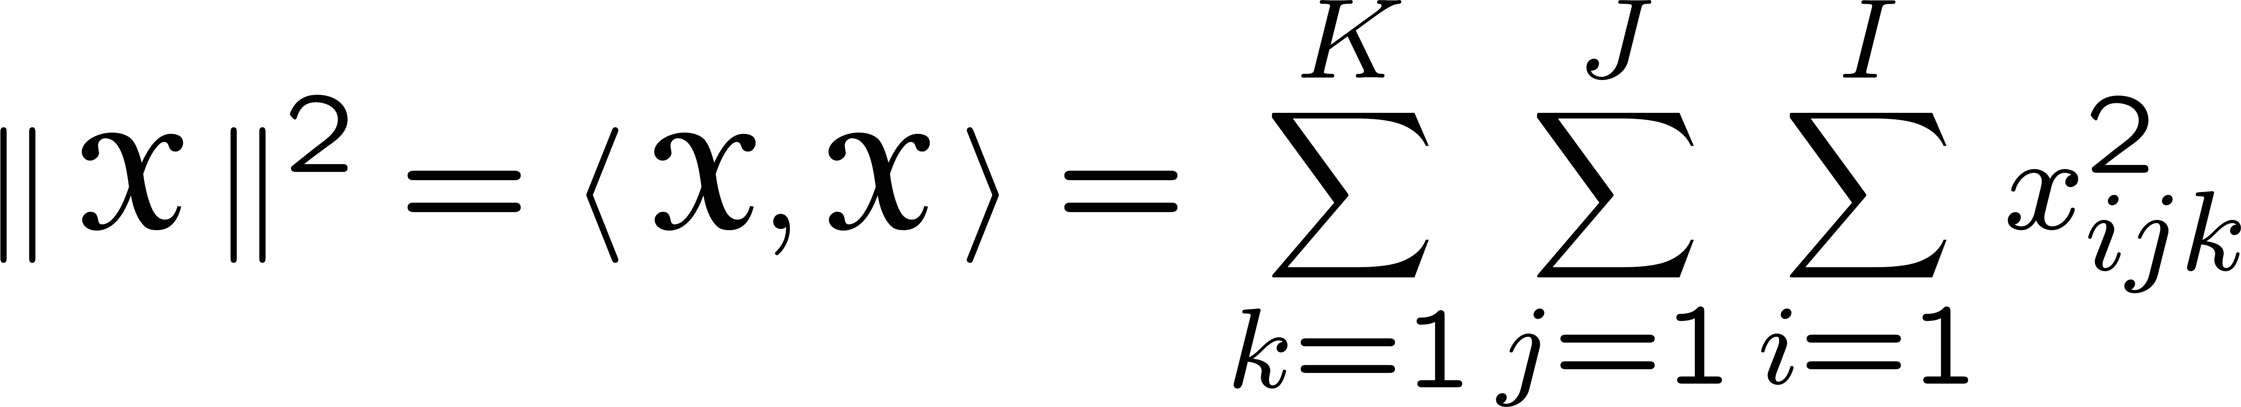




Tensors: Basic Operations (cont.)
Tensor Inner Product
Frobenius Norm
Hadamard Product

Slide 11

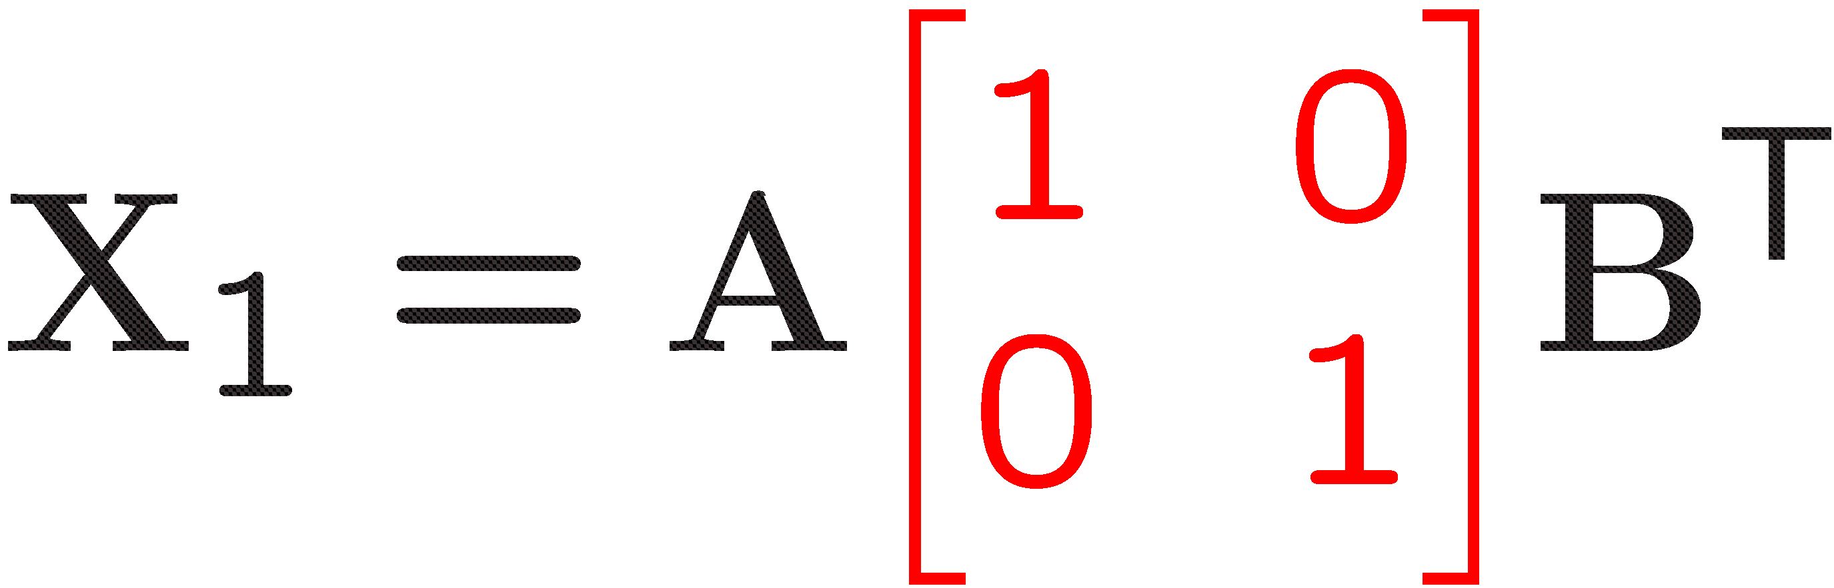
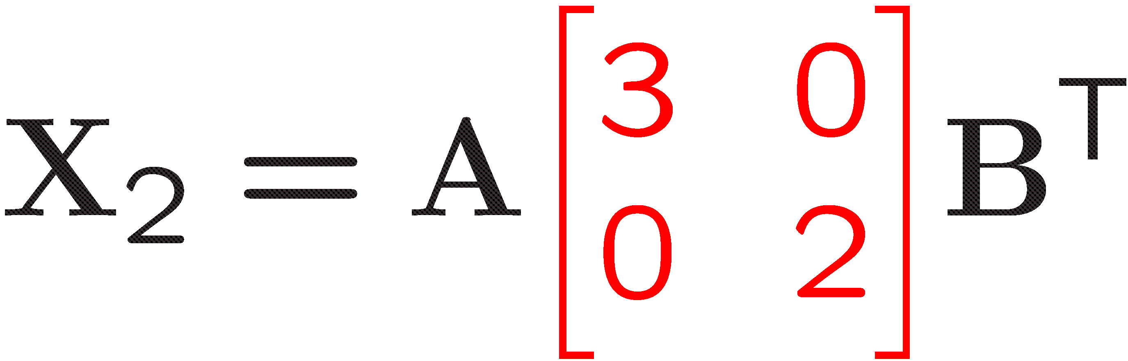





What if we have multiple matrices with the same underlying factors
but in different proportions…
True factors
We can recover the true factors uniquely up to trivial
indeterminacies, i.e., scaling and permutation.

Slide 12










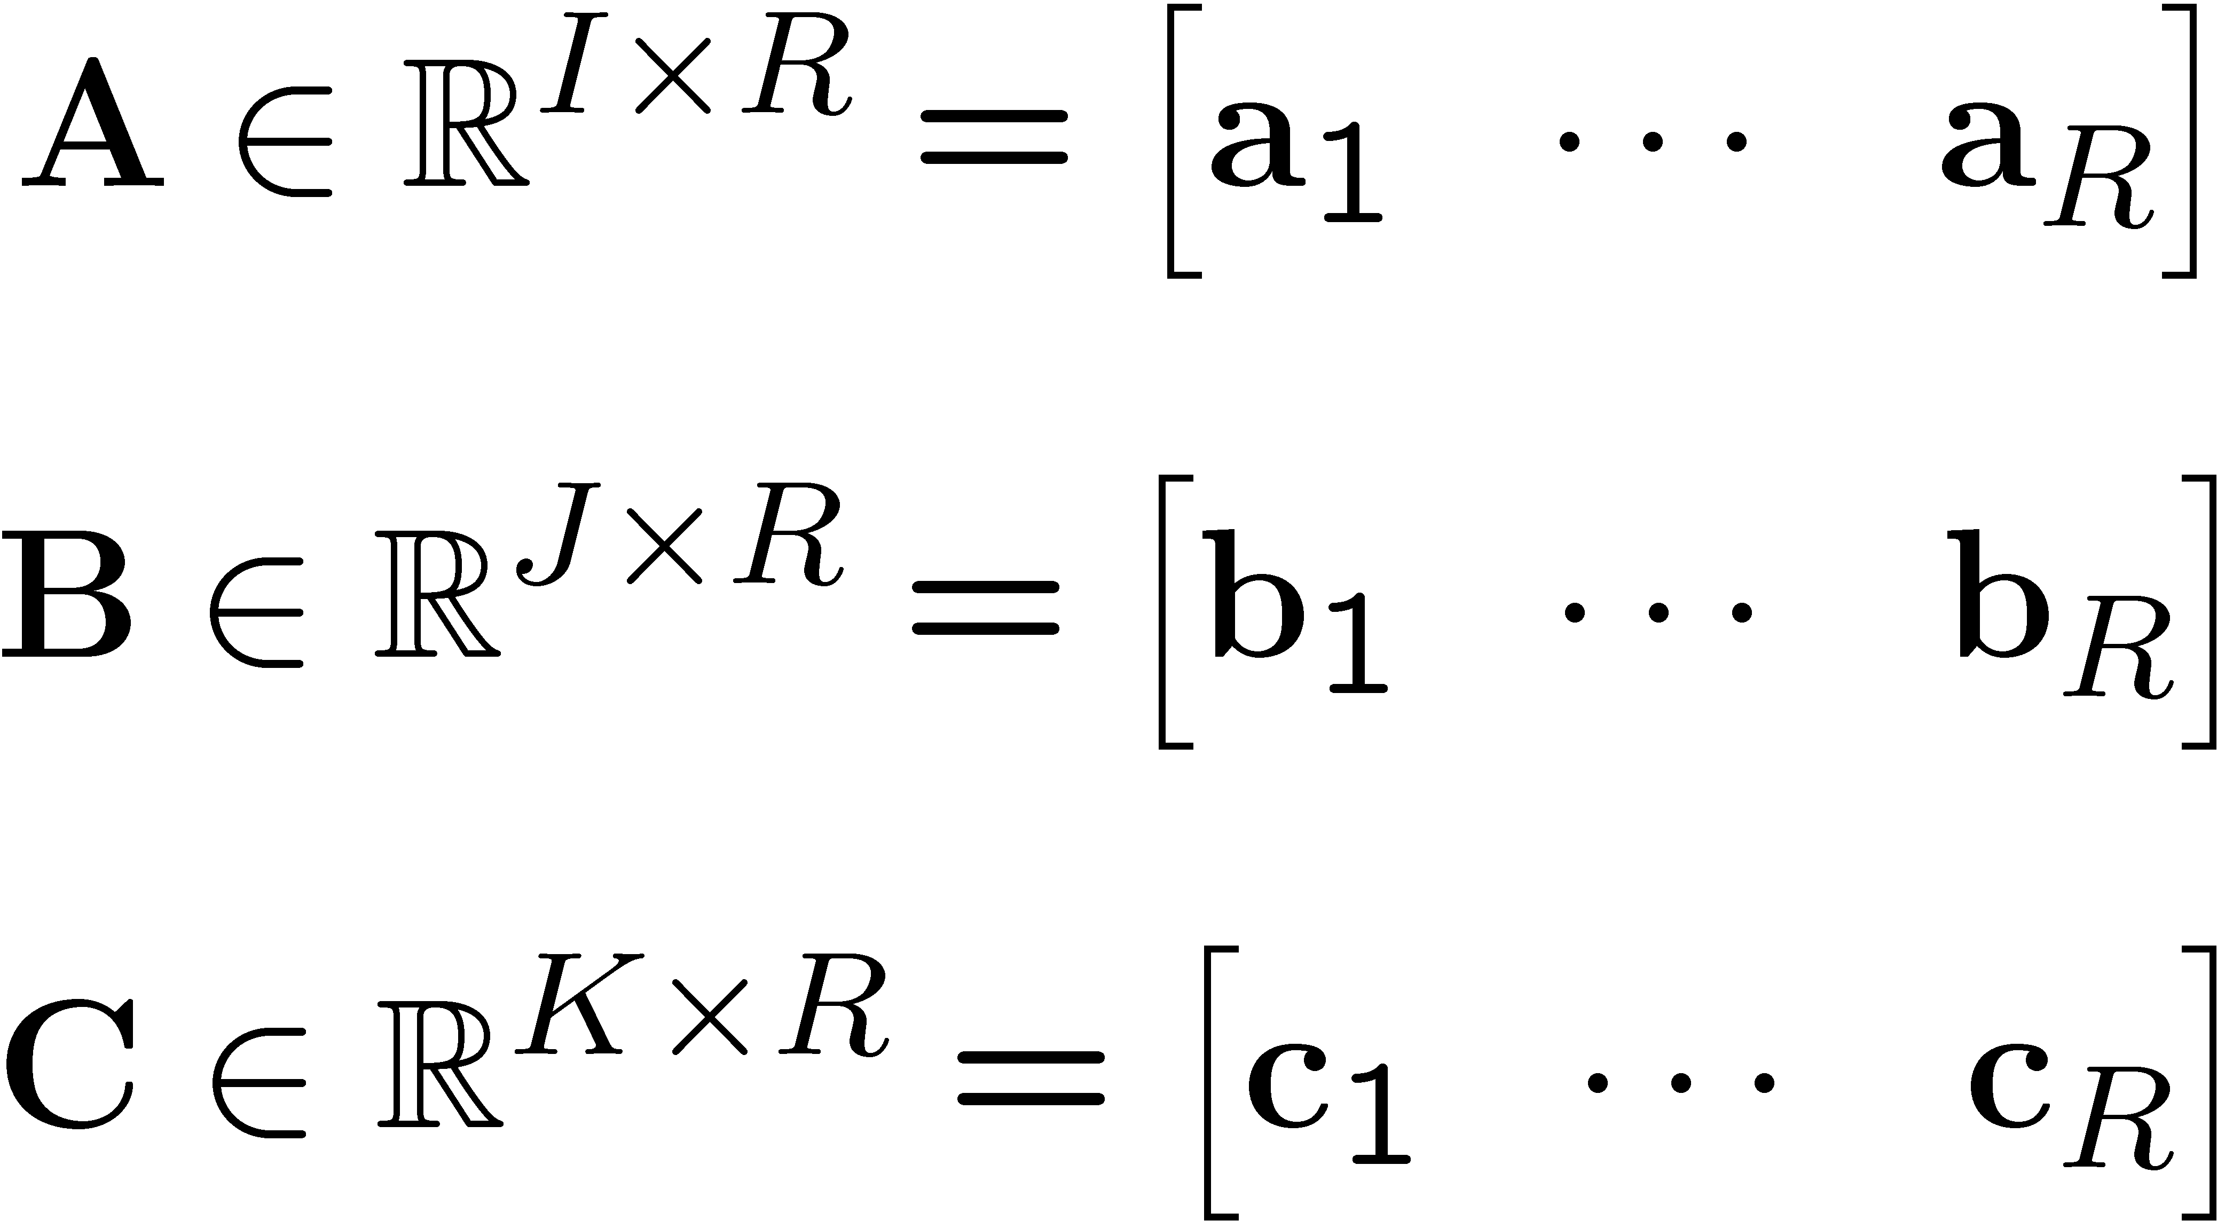
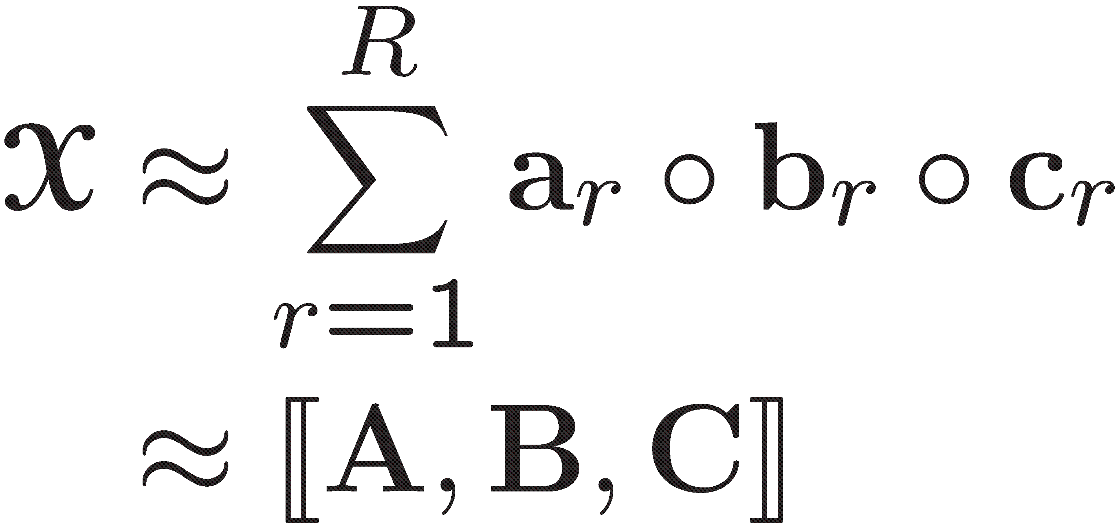
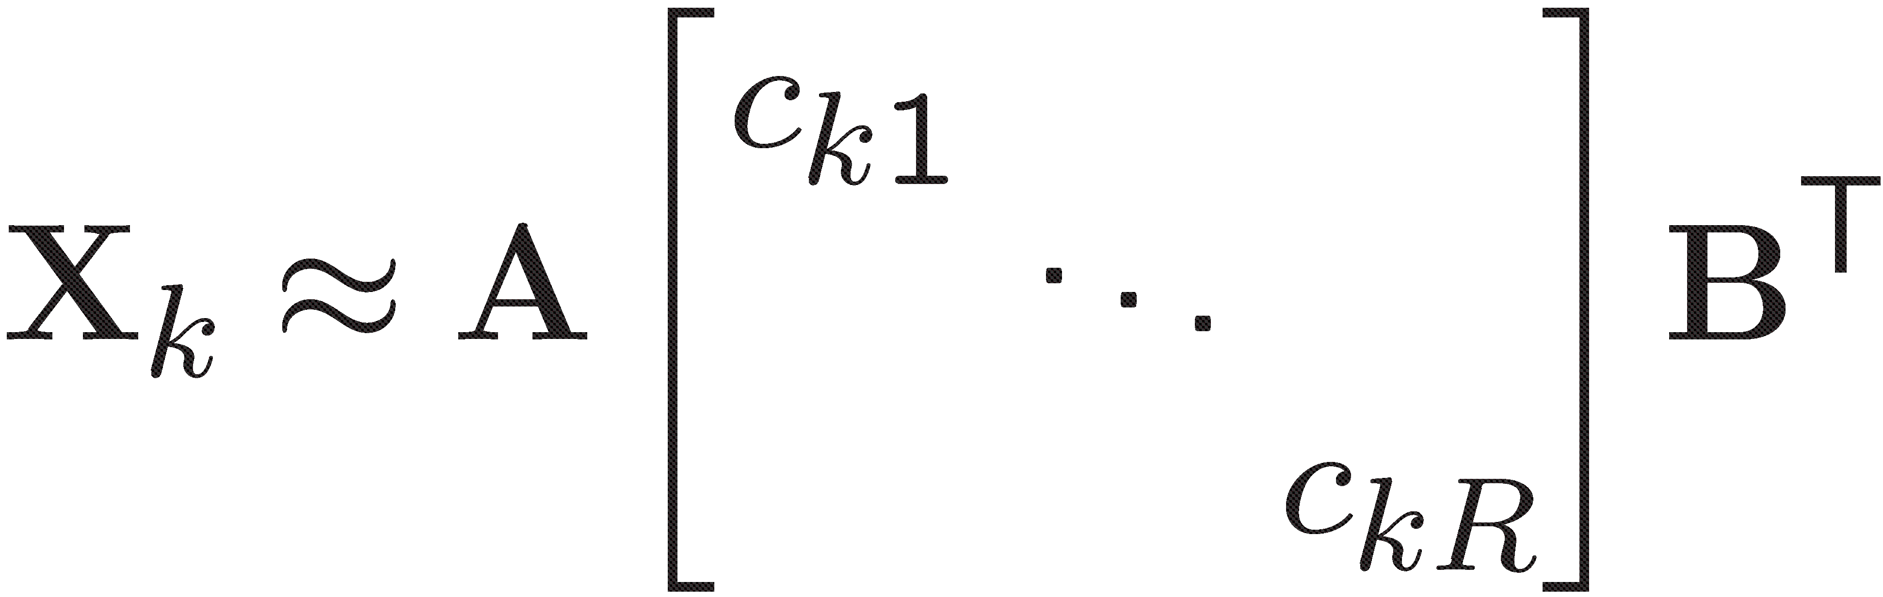
A popular tensor factorization model: CP
Canonical Polyadic (CP)
CANDECOMP/PARAFAC (CP)
Hitchcock, 1927: Polyadic form of a tensor
Harshman, 1970: Parallel Factor Analysis (PARAFAC)
Carroll & Chang, 1970: Canonical Decomposition (CANDECOMP)
As an extension of matrix factorizations to higher-order tensors (multi-way arrays), tensor
factorizations are used to extract the underlying factors in higher-order data sets. The CP model
represents a tensor as a sum of rank-one tensors:
…
≈
+
+
+
I
K
J
CP is unique up to scaling and permutation under the condition that
where krank (A) = max. value of k such that any k columns of A is linearly independent.
[Kruskal, 1977;
Sidiropoulos and Bro, 2000]

Slide 13








CP is unique up to trivial indeterminacies
…
≈
+
+
+
…
scaling
+
+
+
…
permutation
+
+
+

Slide 14









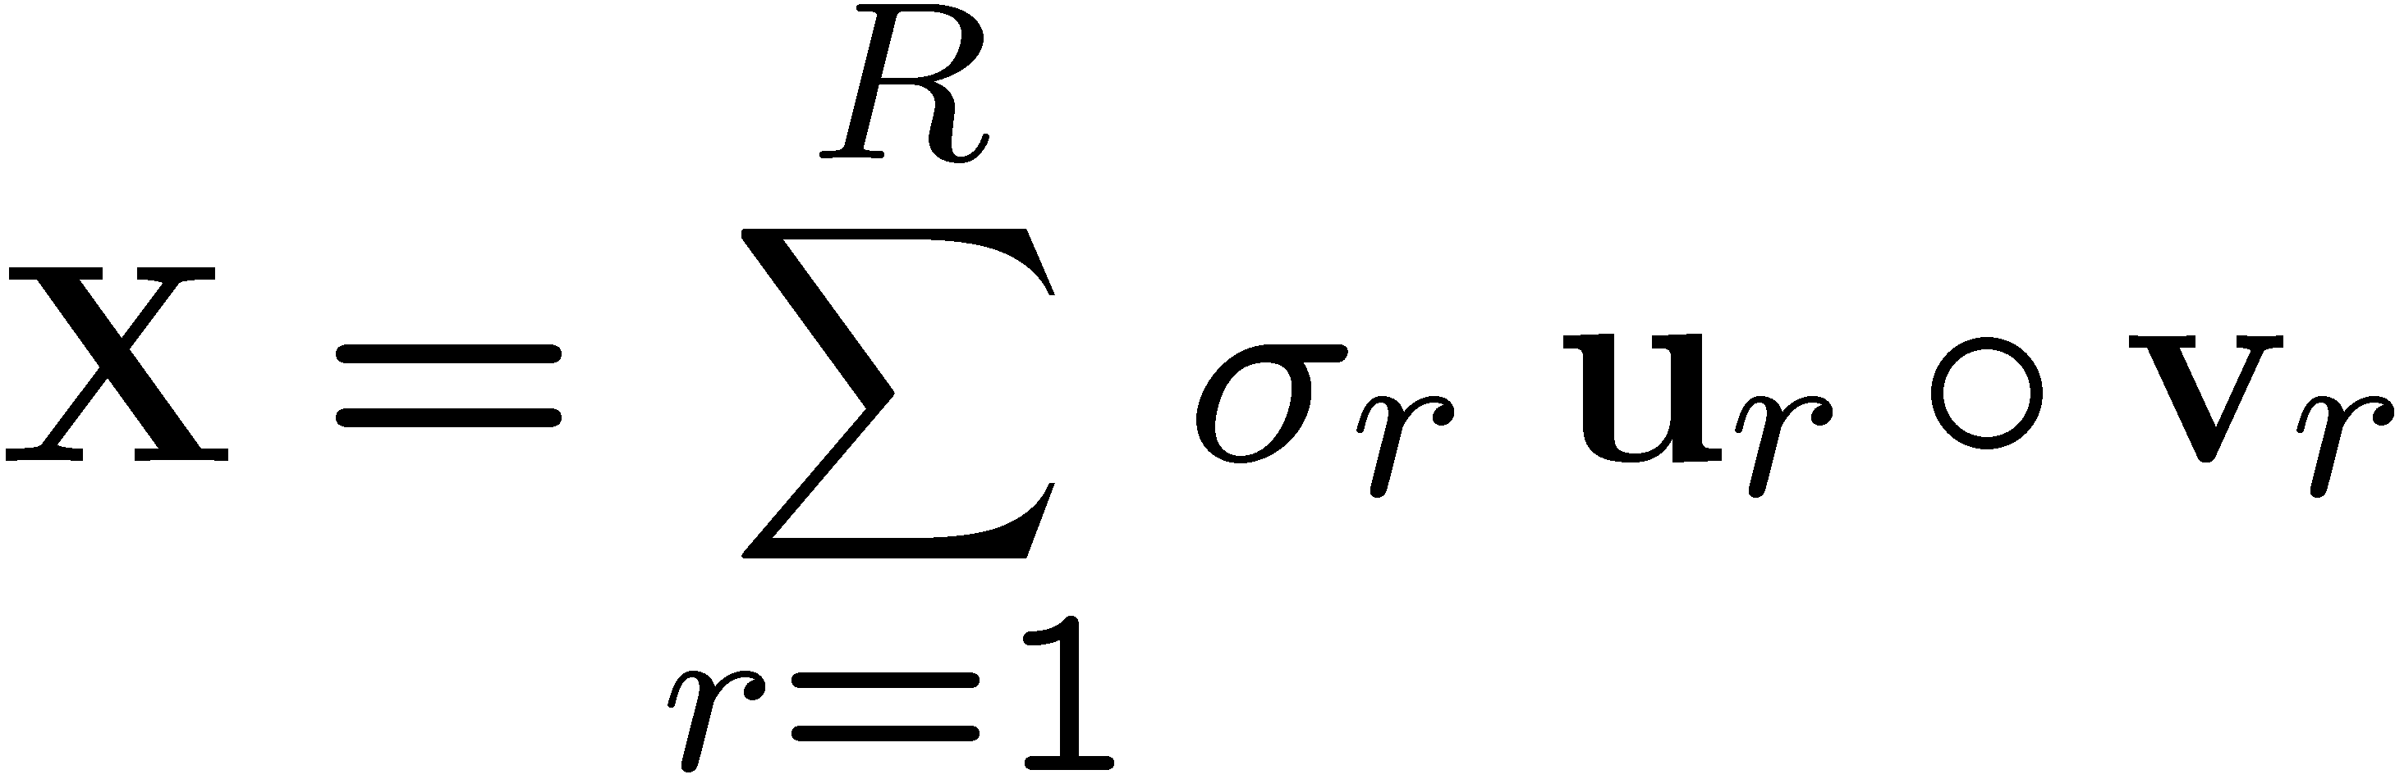
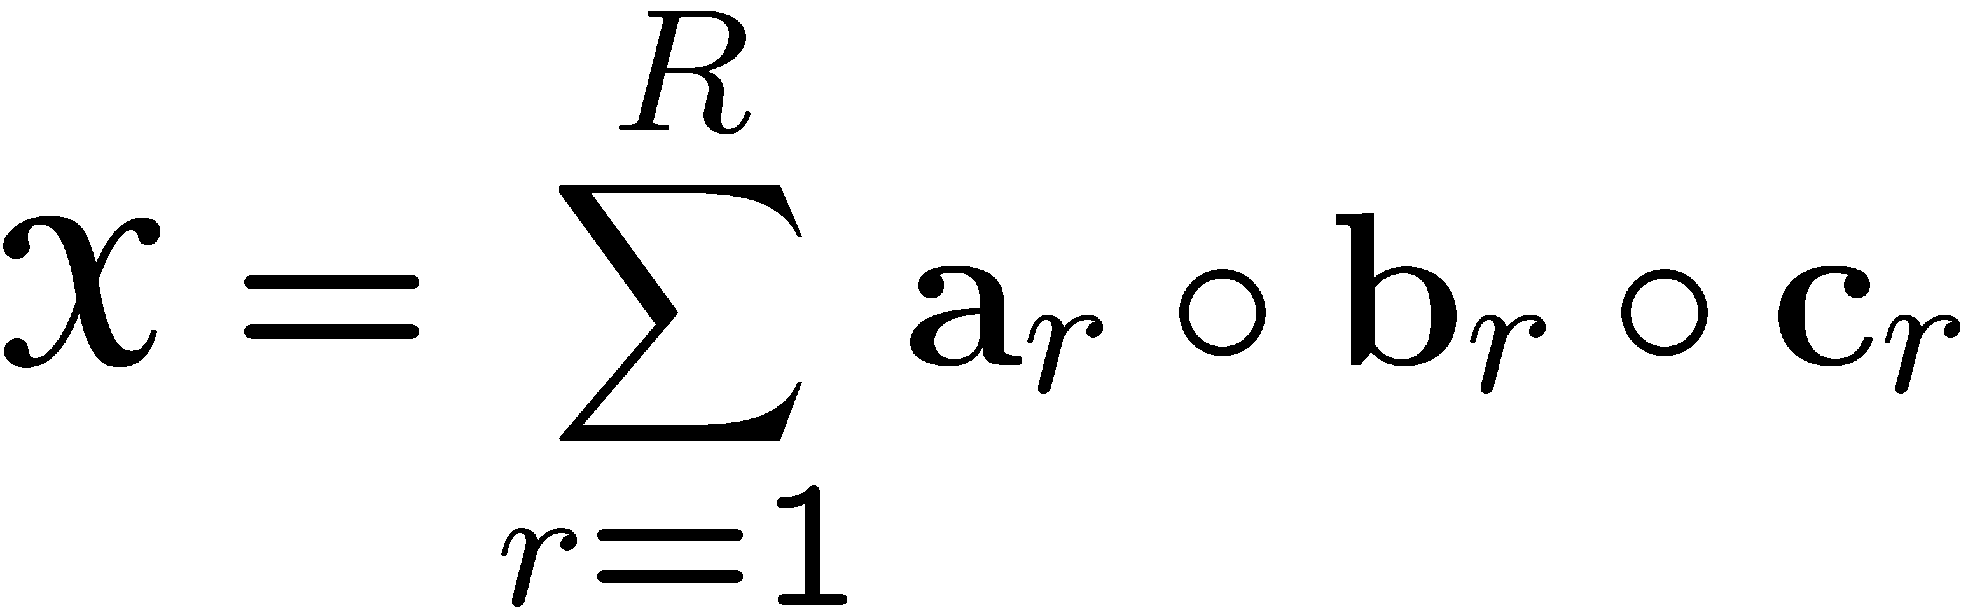
SVD vs. CP
SVD expresses a matrix as the sum of rank-one matrices.
+
+
…
+
=
CP expresses a higher-order tensor as the sum of rank-one tensors.
…
=
+
+
+
CP is an extension of SVD to higher-
order tensors but it is different in
many ways.

Slide 15



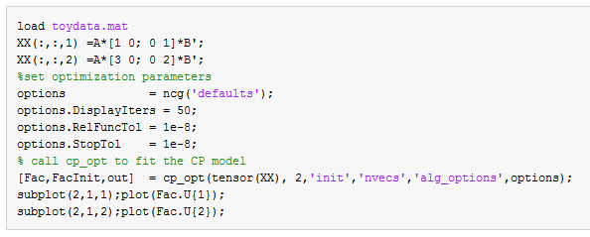
Does it really work?
EXAMPLE:
True factors

Slide 16



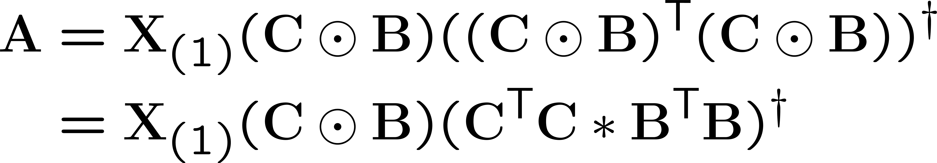


Algorithms for fitting the CP model
The goal is to find matrices A, B, C that solve the following optimization problem:
=
+…+
while “not converged” do
Traditional Approach:
Alternating Least Squares (ALS)
Solve for A (with fixed B, C)
[Harshman, 1970; Carroll & Chang, 1970]
Solve for B (with fixed A and C)
Solve for C (with fixed A and B)
Matricized Tensor Times
Khatri-Rao Product (MTTKRP)
end while
However, better convergence properties and accuracy have been achieved using all-at-
once optimization approaches:
First-order methods: [Paatero, 1999], CP-OPT [Acar, Dunlavy, Kolda, 2011]
Second-order methods: [Paatero, 1997; Tomasi and Bro, 2006; Phan et al., 2013; Sorber et al., 2013]

Slide 17

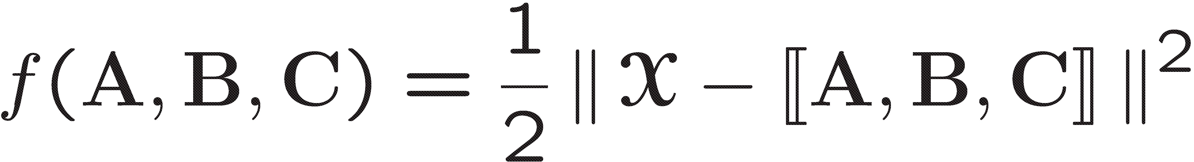
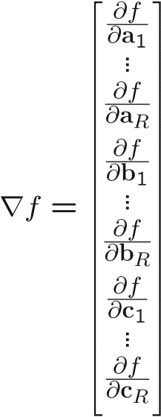
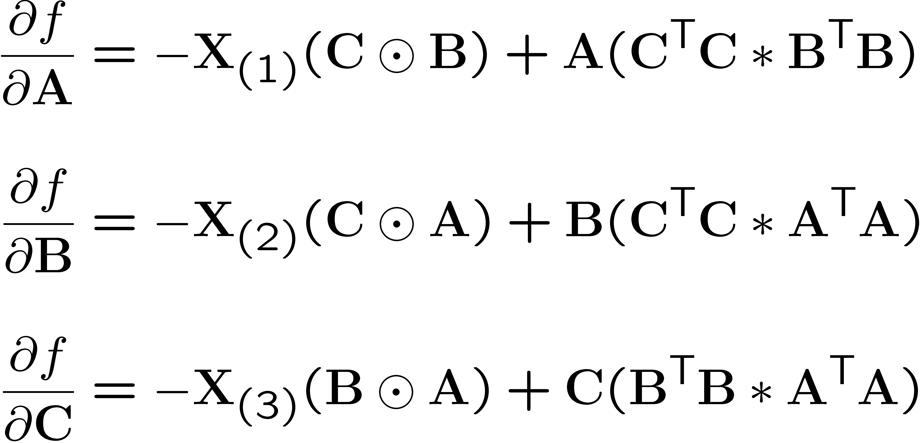
CP-OPT: Gradient-based All-at-once Approach
[Acar, Dunlavy, and Kolda, 2011]
CP-OPT is a general gradient–based optimization approach for fitting a CP model.
=
+…+
Step1: Define the objective function
Step2: Compute the gradient
Remember the ALS steps!
Vectorize and concatenate
the partials
Step3: Pick a first-order optimization method
e.g., Nonlinear Conjugate Gradient (NCG) from the Poblano Toolbox [Dunlavy, Kolda and Acar, 2010]

Slide 18
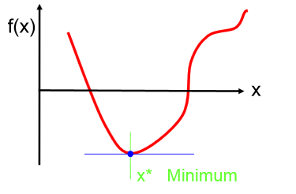
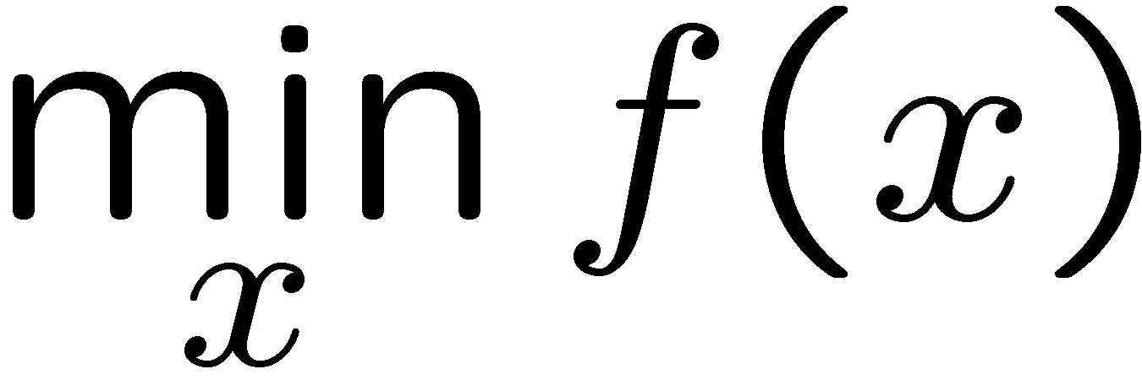
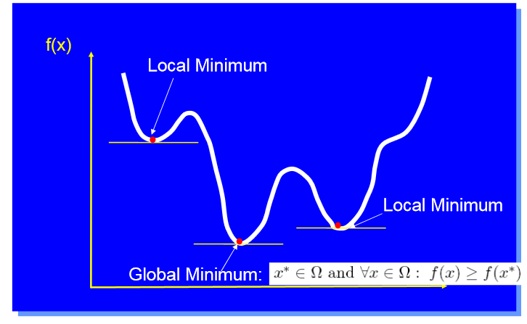
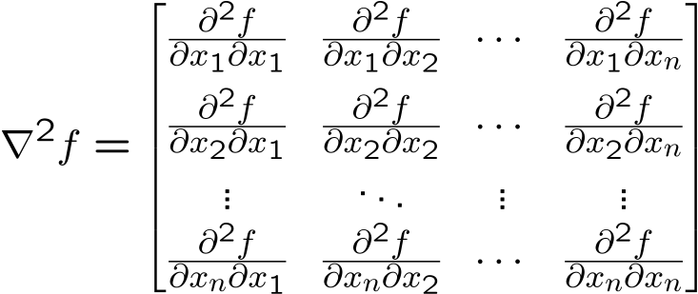
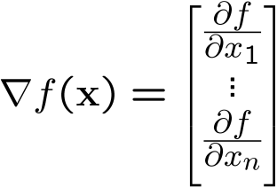
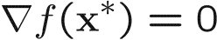
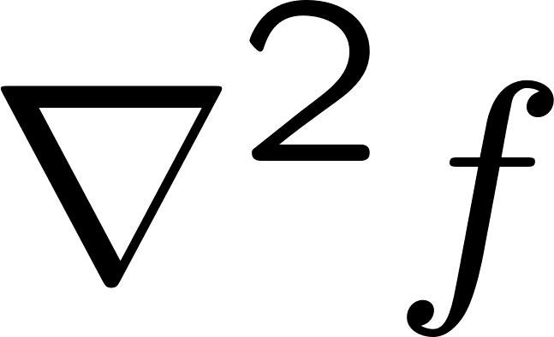
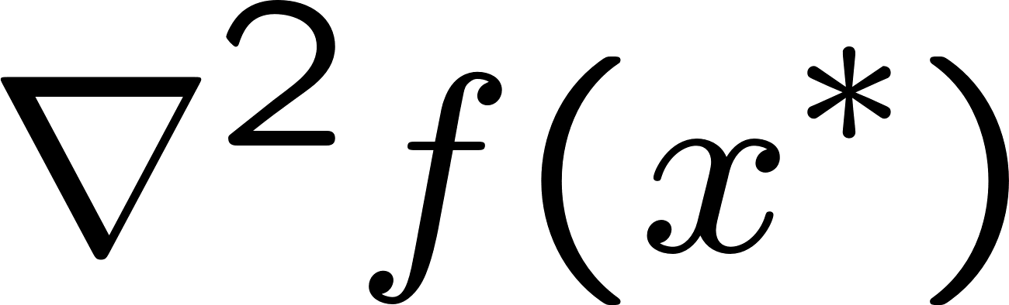
Few words on optimization
Optimization problem
Figures from Moritz Diehl’s slides
Aim of most optimization algorithms
Find a local minimizer x*
Gradient
Hessian
First-order Necessary Conditions
If x* is a local minimizer and f is continuously differentiable in an open neighborhood of x*, then
.
Second-order Necessary Conditions
If x* is a local minimizer of f and exists and is continuous in an open neighborhood of x*, then and is positive semidefinite.

Slide 19



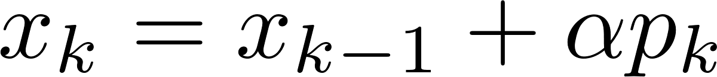
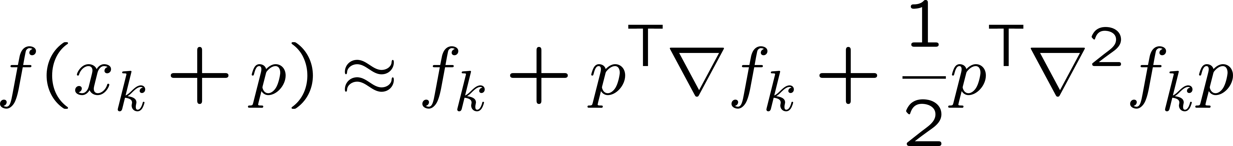
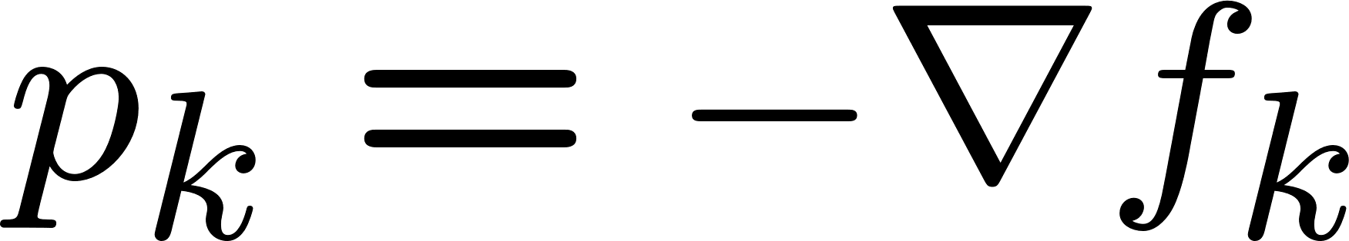
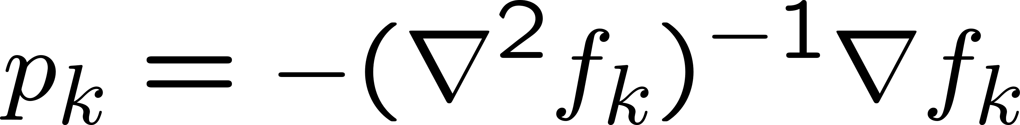
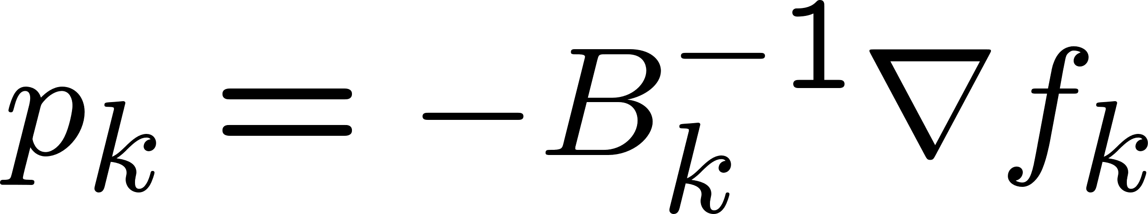
Few words on optimization (cont.)
The general structure of the optimization algorithms in the Poblano Toolbox:
choose a starting value
while not converged do
find the search direction
determine the step length
new iterate
end while
Different choices of search direction
and step length lead to different
optimization algorithms.
Taylor’s approximation:
Suppose that f is twice continuously differentiable, then,
Steepest descent:
Newton’s direction:
Quasi-Newton Methods
(e.g., Limited-Memory BFGS):
Nonlinear Conjugate Gradient Methods:
The ones using only
the first-order info
are implemented
in the Poblano
Toolbox.

Slide 20
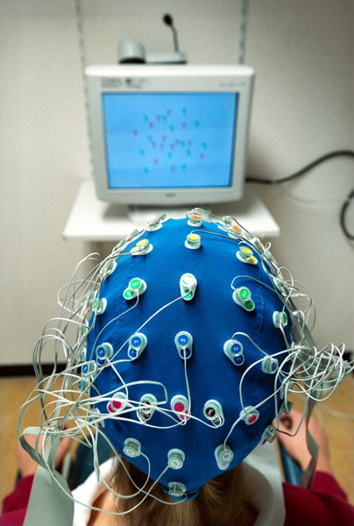
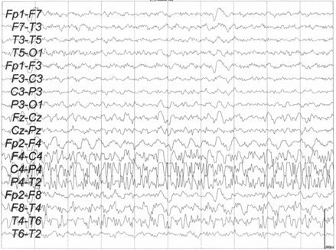
Application₁ (Neuroscience): CP has proved useful in epileptic seizure
localization
[Acar et al., 2007; De Vos et al., 2007]
CWT
time
time
channels
archlab.gmu.edu
channels
frequency
Eye artifact
time
frequency
channels
≈
+
time
time
frequency
channels
channels
Seizure
frequency

Slide 21
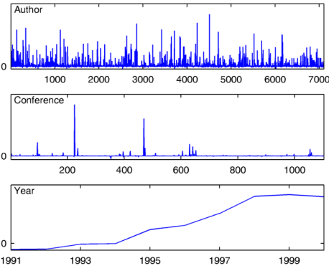

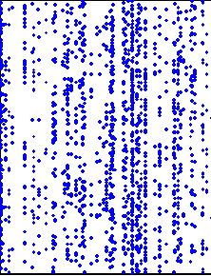
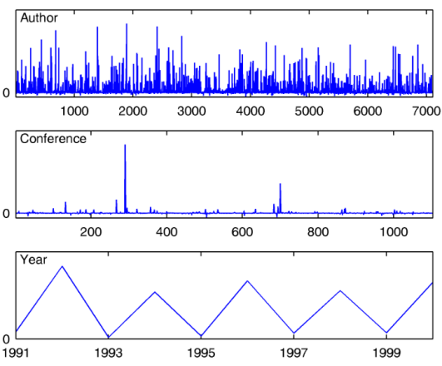
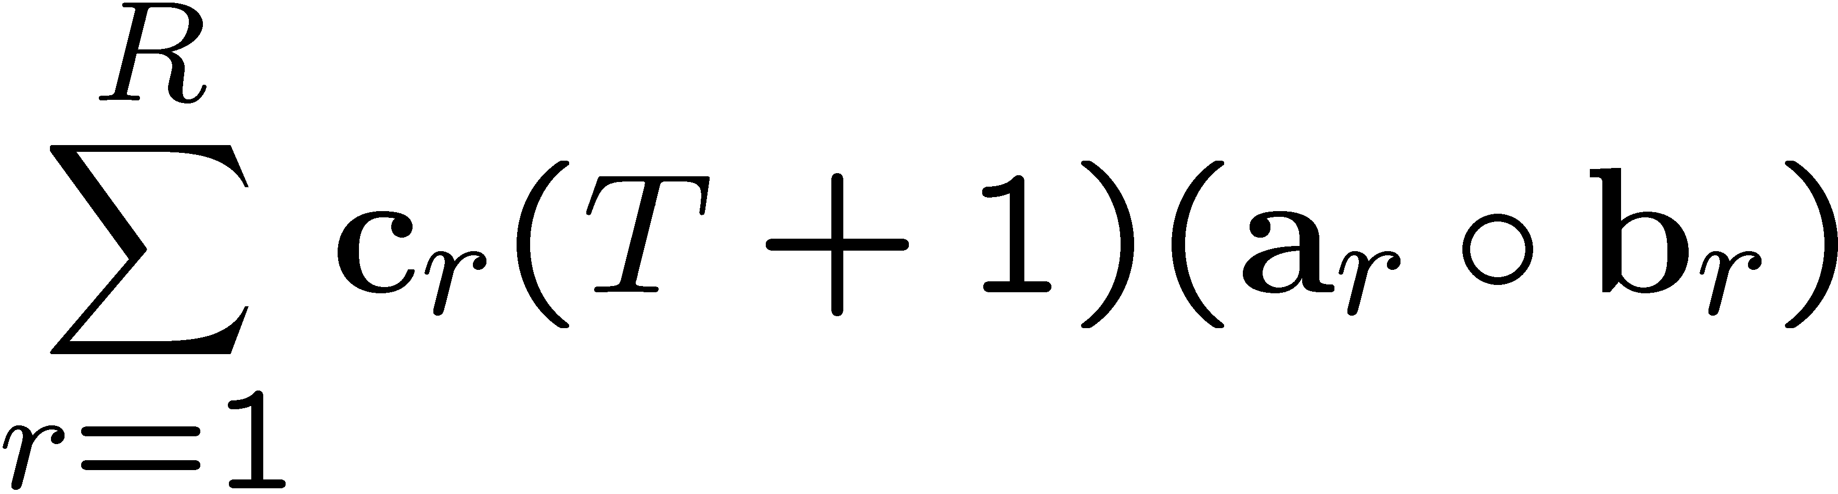


Application₂ (Recommender Systems): CP can capture temporal patterns useful for link prediction
[Dunlavy, Kolda, Acar, 2011]
Temporal Link Prediction
Which customers will buy which products?
Which webpages will users visit?
T
T+1
years
…
T+1
2
1
+
≈
authors
+
conferences

Slide 22



Application₃ (Chemometrics): CP can separate the chemicals in mixtures
[Andersen and Bro, 2003]
A popular application of the CP model is the separation of individual chemicals from mixtures of
chemicals measured using fluorescence spectroscopy.
≈
+
+
mixtures
excitation
emission
Amino Acid Data
http://www.models.life.ku.dk/

Slide 23
Application₃ (Chemometrics): CP can separate the chemicals in mixtures
[Andersen and Bro, 2003]
A popular application of the CP model is the separation of individual chemicals from mixtures of
chemicals measured using fluorescence spectroscopy.
≈
+
+
mixtures
excitation
emission
Amino Acid Data
http://www.models.life.ku.dk/
≈
+
+

Slide 24
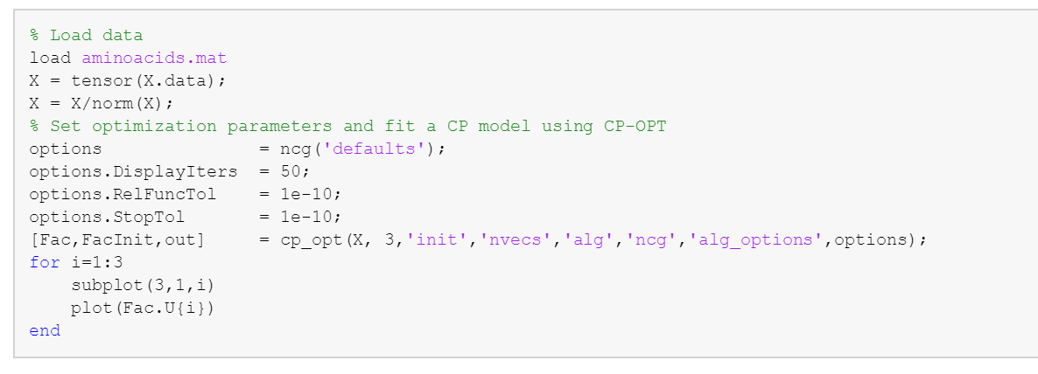
Modeling the aminoacids data
Model: CANDECOMP/PARAFAC (CP)
Algorithm: We can pick a gradient-based optimization method
Nonlinear Conjugate Gradient (ncg)
Limited–memory BFGS (lbfgs)
….
Initialization of factor matrices:
svd-based
entries randomly sampled from a standard normal distribution
pre-defined cell array containing the factor matrices

Slide 25













SVD-based Initialization
Left singular vectors (i.e., U₁, U₂, U₃) of matricized tensors in each mode can be used to initialize
the factor matrices.

Slide 26



Tensor Factorizations: Missing Data Estimation (a.k.a. Tensor Completion)
Similar to the matrix case, in the case of missing data we can use low-rank tensor approximations
to fill in missing entries [Tomasi and Bro, 2005]:
locations
…
≈
=
+
+
+
users
activities
Finding low-rank approximation:
Data reconstruction:

Slide 27






In the presence of missing data: CP-WOPT
[Acar, Dunlavy, Kolda, Mørup, 2011]
CP-WOPT (CP Weighted OPTimization) solves the following weighted optimization problem to fit the CP model to the known data entries in the tensor by ignoring the missing entries:
=
+…+
Step1: Define the objective function
Step2: Compute the gradient
Step3: Pick a first-order optimization method
Vectorize and concatenate
the partials

Slide 28




Tensor Completion Example
+
=
+

Slide 29

Tensor Completion Example (cont.)
+
=
Notes:
Then we will randomly drop some entries (approximately 50% of the entries)

Slide 30


Tensor Completion Example (cont.)
≈
+
Notes:
Then model this incomplete tensor using CP-WOPT, find the factor matrices , reconstruct the tensor and compare the estimated values with the original values of the missing entries

Slide 31
CP-WOPT can accurately capture the factors even with high amounts of
missing data!
mixtures
excitation
emission
50% Missing Data
mixtures
excitation
emission

Slide 32



CP-WOPT scales to large problems!
500 x 500 x 500 with 99% missing
entries (i.e., 1.25 million known entries)
1000 x 1000 x 1000 with 99.5% missing entries (i.e., 5 million known entries)
Dense storage = 1GB
Sparse storage = 40MB
Dense storage = 8GB
Sparse storage = 160MB
Factor Match Score
On a Linux workstation with 2 Quad-Core Intel Xeon 3.0 GHz processors and 32 GB RAM

Slide 33










Application₄ (Neuroscience): We can capture underlying factors accurately from EEG data with missing channels
[Acar, Dunlavy, Kolda, Mørup, 2011]
Goal: To differentiate between left and right hand stimulation
subjects
≈
+
+
channels
http://www.madehow.com/
time-frequency

Slide 34







Application₄ (Neuroscience): We can capture underlying factors accurately from EEG data with missing channels
[Acar, Dunlavy, Kolda, Mørup, 2011]
Goal: To differentiate between left and right hand stimulation
subjects
≈
+
+
channels
http://www.madehow.com/
time-frequency
No Missing Data
30 Channels/slice Missing

Slide 35


















Ignoring missing entries vs. Imputation
Ignoring missing entries, in particular, when there is large amount of missing data is
better than alternatives based on imputation, e.g., imputing missing entries with mean.
CP-WOPT
subjects
+
+
≈
+
+
channels
time-frequency
IMPUTATION
+
+

Slide 36


Ignoring missing entries vs. Imputation
Ignoring missing entries, in particular, when there is large amount of missing data is
better than alternatives based on imputation, e.g., imputing missing entries with mean.
CP-WOPT
subjects
+
+
≈
+
+
channels
time-frequency
IMPUTATION
+
+
sim: Similarity score similar to the
previously defined Factor Match Score (FMS)
CP-WOPT
IMPUTATION

Slide 37
Ignoring missing entries vs. Imputation
Ignoring missing entries, in particular, when there is large amount of missing data is
better than alternatives based on imputation, e.g., imputing missing entries with mean.
CP-WOPT
subjects
+
+
≈
+
+
channels
time-frequency
IMPUTATION
+
+
CP-WOPT
IMPUTATION

Slide 38
Ignoring missing entries vs. Imputation
Ignoring missing entries, in particular, when there is large amount of missing data is
better than alternatives based on imputation, e.g., imputing missing entries with mean.
CP-WOPT
subjects
+
+
≈
+
+
channels
time-frequency
IMPUTATION
+
+
CP-WOPT
IMPUTATION

Slide 39








Another popular tensor factorization model: Tucker
[Tucker, 1963 & 1964 & 1966]
A more flexible tensor factorization model compared to the CP model is the Tucker3 model, which
models a third-order tensor using three factor matrices corresponding to each mode as well as a
core array.
R
K
K
Q
P
R
I
J
P
I
Q
J
Tucker with orthogonality constraints on A, B, and C corresponds to the
best rank-(P,Q,R) approximation of the tensor.

Slide 40

Tucker is considered to be another generalization of SVD to higher-order
tensors: Higher-order SVD (HOSVD)
[Tucker, 1966; De Lathauwer, De Moor, Vandewalle, 2000]
Truncation of HOSVD gives a good
rank-(P,Q,R) approximation
R
Q
P
P
Q
R

Slide 41

Tucker vs. CP
Tucker
CP
R
R
K
K
K
Q
K
R
P
R
R
I
J
I
J
I
P
I
Q
J
J
More flexible than CP
Different number of components in each mode
The core tensor models the interaction between factors in different modes
Restricted model with a specific structure
Same number of components in each mode
Super-diagonal core tensor
Not-unique
Nice uniqueness properties
EXPLORATORY DATA ANALYSIS &
COMPRESSION!
INTERPRETABILITY!!!

Slide 42



Application₅ (Face Recognition): TensorFaces
[Vasilescu and Terzopoulos, 2003]
Facial image data tensor with modes (people x viewpoints x illuminations x expressions x pixels) is constructed by arranging the images from 28 people in 5 viewpoints, 4 illuminations and 3 expressions.
HOSVD gives the following:
eigenfaces
tensorfaces
Better face recognition performance using tensorfaces compared to eigenfaces
Truncation in the
illumination mode:

Slide 43



Similar to CP, Tucker model can be fit to incomplete data using weighted optimization!
R
R
K
K
K
R
Q
K
P
R
Q
I
P
J
P
I
I
P
J
Q
I
J
Q
J

Slide 44









There are other tensor factorization models
Mainly for applications with uniqueness & interpretability concerns
PARALIND (Parallel profiles with Linear Dependences)
PARAFAC2
[Harshman, 1972]
[Bro, Harshman, Sidiropoulos, Lundy, 2009]
K
DEDICOM (Decomposition into directional components
Handles differences between factors across different slices. Similar in that sense, there are also Shifted PARAFAC and Convolutive PARAFAC.
[Harshman, 1978]
Image from
[Kolda & Bader, 2009]
Mainly for compression & reconstruction applications and higher-order
tensors with many modes, e.g., 10th-order tensor
Tensor Train (TT)
And hierarchical tucker (H-Tucker)
[Oseledets, 2011]
Sequences of SVDs on various unfoldings:
Image from
[Papalexakis et al., 2017]

Slide 45







There are many other applications of tensor factorizations
Urban Computing
Travel Time Estimation [Wang et al., KDD, 2014]
Social Network Analysis
[Papalexakis et al., PKDD, 2012]
road segments x drivers x time slots
wall owner x poster x day
Electronic Healthcare Records
EHR-based Phenotyping [Henderson et al., ICHI, 2017]
patients x medications x diagnosis
Computer Vision
original
observed
reconstruction
Image Reconstruction:
[Liu et al., PAMI, 2013]
Tensor: original color image with color channels

Slide 46




Active Research Areas
[Acar, Anandkumar, Mullin, Rusitschka, Tresp, 2018]
Scalability
Parallel and distributed computations [Smith and Karypis, 2016], [Kaya and Ucar, 2015 & 2016]
Portability to emerging architectures [Phipps et al., 2017]
Sampling [Phan and Cichocki, 2011; Papalexakis et al., 2012; Vervliet and De Lathauwer, 2016; Battaglino et al., 2018]
Different Loss Functions [Yilmaz, Cemgil, Simsekli, 2011; Ermis, Acar, Cemgil, 2015] [Kolda et al., Presented at TRICAP, 2018] [Vandecappelle et al., Presented at TRICAP, 2018]
Deep Learning and Tensor Factorizations
Tensor Train Factorization of a Feed Forward Layer [Novikov, Podoprikhin, Osokin, Vetrov, 2015]
TT-Recurrent Neural Networks [Yang, Krompass, Tresp, 2017]
Software
MATLAB: Nway Toolbox, Tensor Toolbox, TT Toolbox, TensorLab
R: multiway
Sparse: http://frostt.io/
Data Sets
Dense: www.models.life.ku.dk

Slide 47
Summary
Matrix Factorizations: How to use matrix factorizations to (i) find the underlying factors, (ii) predict missing entries
Matrix factorizations without constraints are not unique.
Constraints need to make sense in terms of the application; otherwise, the model will not
reveal what we are looking for.
Tensor Factorizations
Tensor factorization methods such as CP have better
uniqueness properties compared to matrix factorizations.
How to use tensor factorizations, in particular, CP,
to find the underlying factors, e.g.,
Chemometrics
Neuroscience
Temporal Link Prediction
How to fit a CP model to a higher-order tensor with
missing entries
Algorithms: ALS, Gradient-based optimization approaches
MATLAB functions
cp-opt: Fitting a CP model to a tensor (from Tensor Toolbox)
[Fac, FacInit, output] = cp_opt(X, R, ‘init’, ‘random’, ‘alg’,’ncg’, ‘alg_options’, options);
cp-wopt: Fitting a CP model to a tensor with missing entries (from Tensor Toolbox)
[Fac, FacInit, output] = cp_wopt(X, W, R, ‘init’, ‘random’, ‘alg’,’ncg’, ‘alg_options’, options);

Slide 48

Model: Optimization problem
Tensor Toolbox
Computation of the function value and the gradient
cp_opt
cp_wopt
Poblano Toolbox
Gradient-based optimization algorithms
ncg, lbfgs, …

